Slide 1
Drag and Drop
Представена от: Ирина Христова, 62473

Slide 2
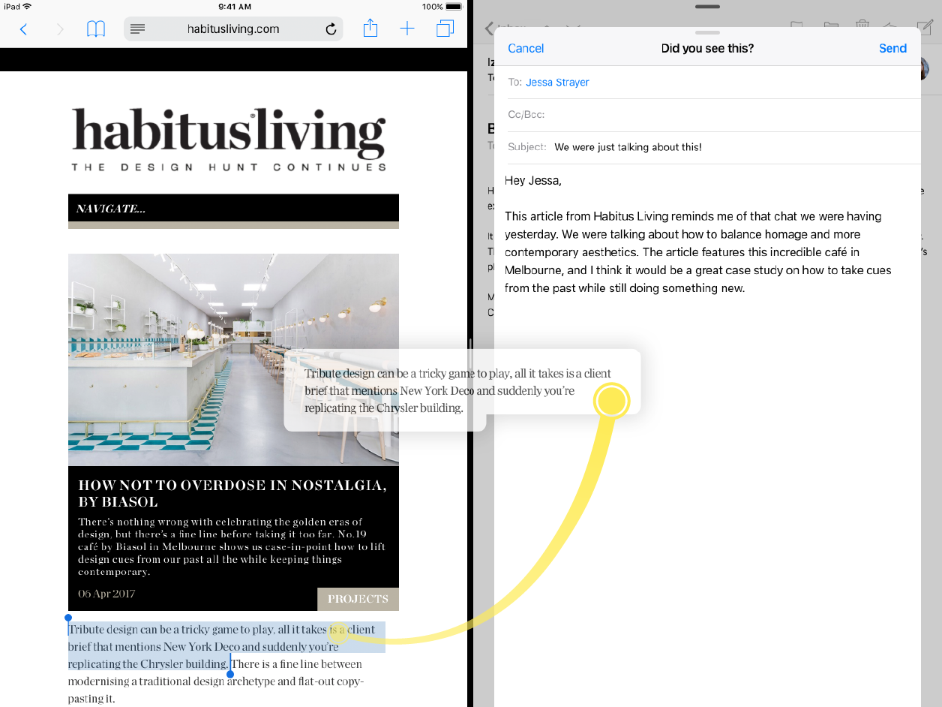
What is Drag and Drop ?

Slide 3
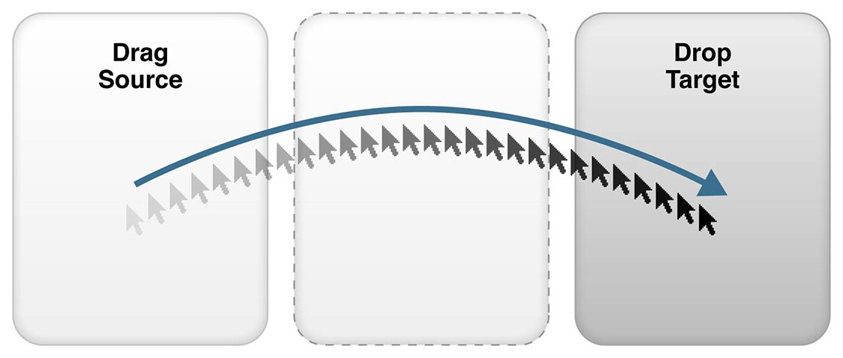
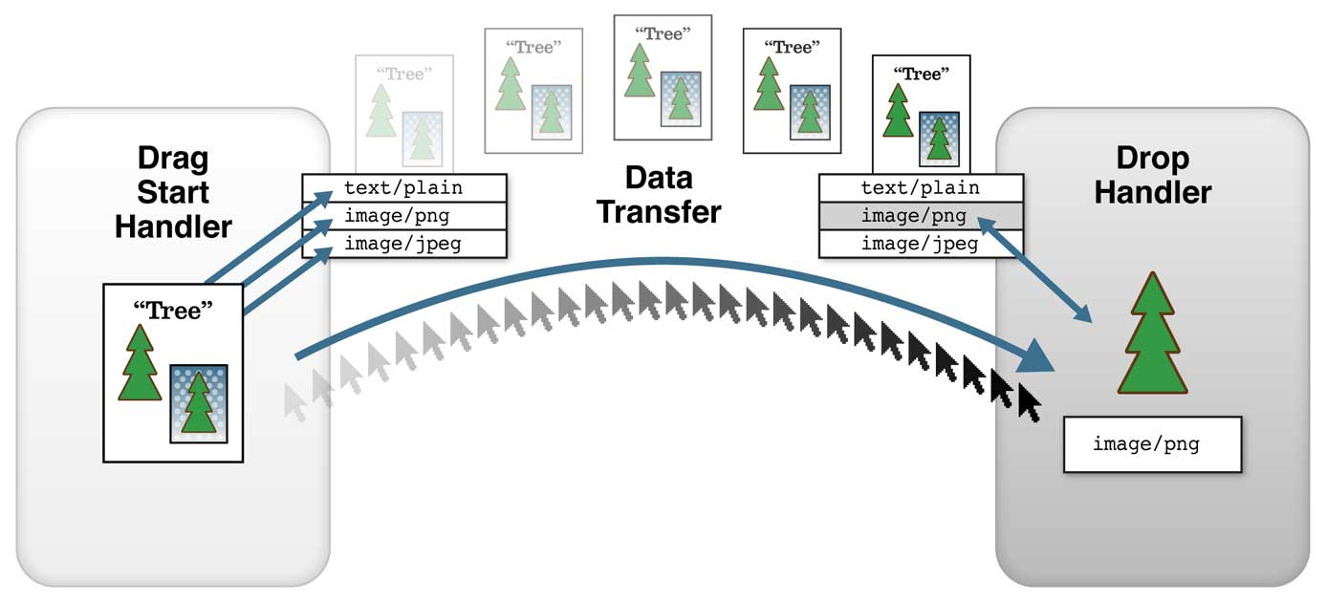
Drag source, drop target and data transfer

Slide 4
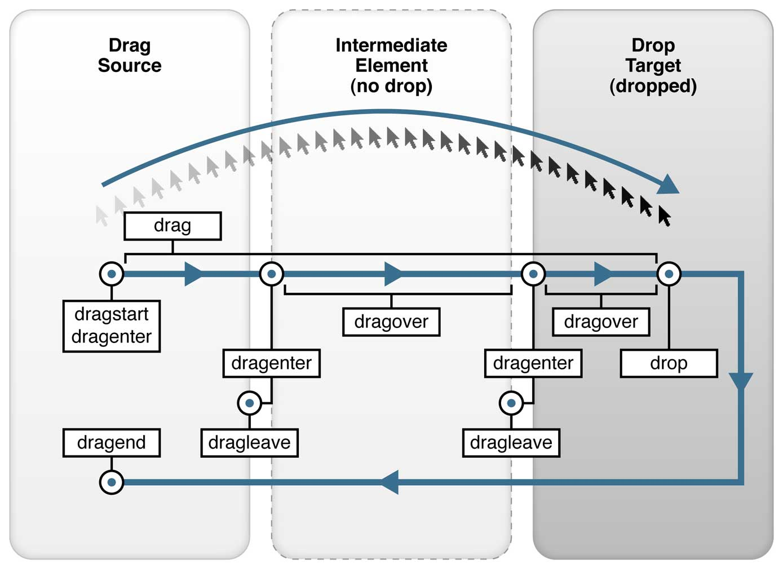
Drag and Drop events

Slide 5
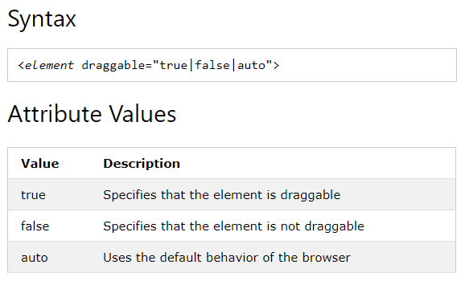
Draggable

Slide 6
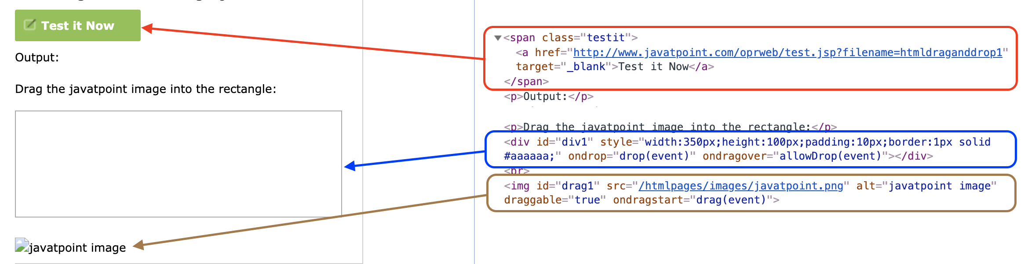
Example

Slide 7


Slide 8


